Slide 1
WCP52 USB Gain/Phase Analyzer
Low-cost, open-source gain/phase analyzer

Slide 2
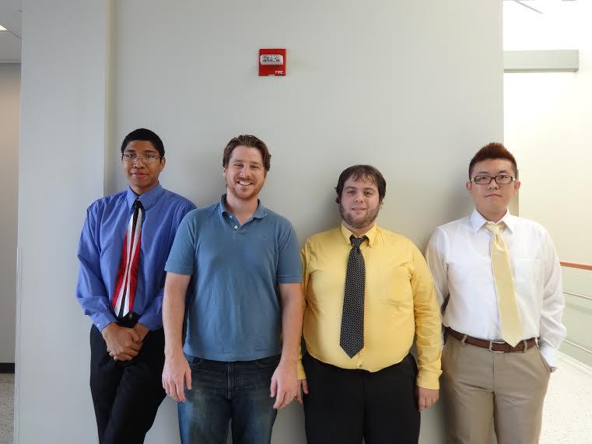
WCP52 USB Gain/Phase Analyzer
Key Personnel
Chris Pavlina- EE Student Team Lead
Kaidi Xu- EE Student
Kenneth Zachary- CoE Student
Harrison Owens- CoE Student
Prof. Kyle Temkin- Faculty Advisor
Prof. Maynard - Program Manager
[Pictured Left to Right: Harrison Owens,Kenneth Zach,
Chris Pavlina, Kaidi Xu]

Slide 3
WCP52 USB Gain/Phase Analyzer
Executive Summary
We are creating a USB driven device that analyzes the frequency response of filters, amplifiers, and control systems and creates a corresponding Bode Plot of the analysis.

Slide 4
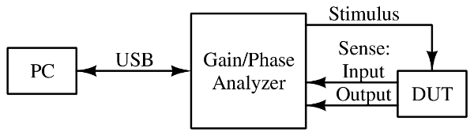
WCP52 USB Gain/Phase Analyzer
Context Diagram

Slide 5
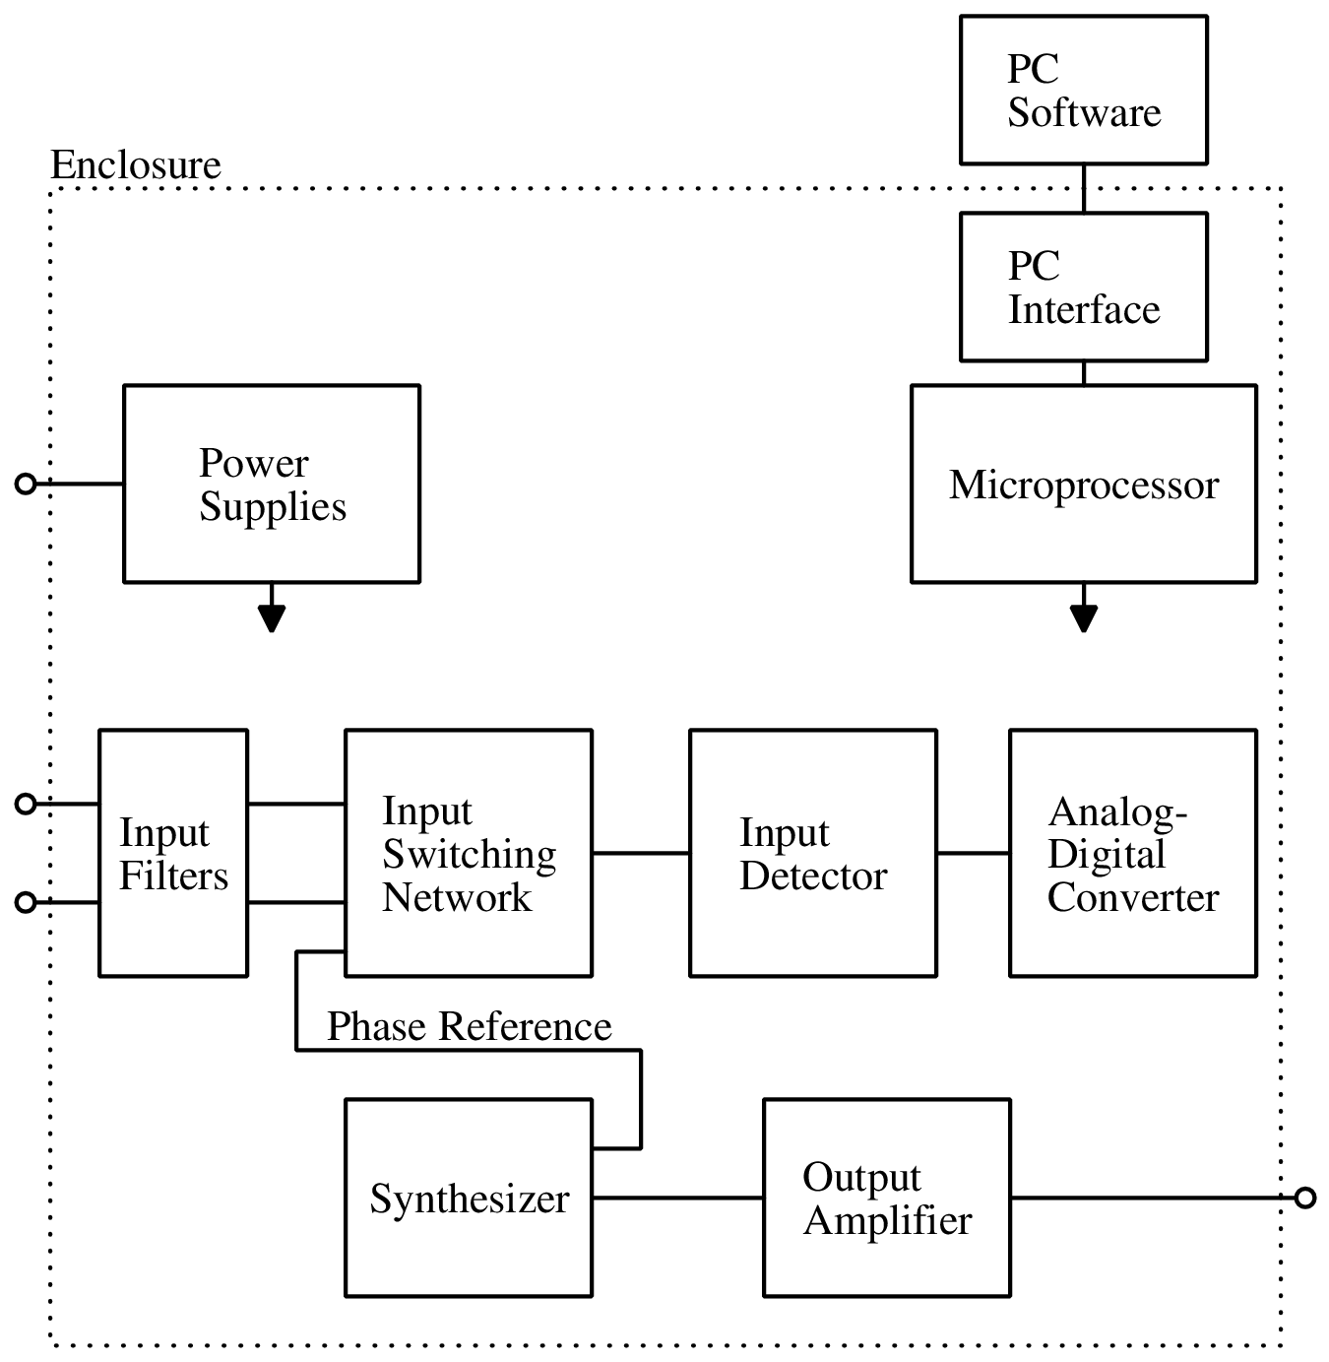
WCP52 USB Gain/Phase Analyzer
System Diagram

Slide 6
WCP52 USB Gain/Phase Analyzer
System Architecture
Hardware:
Signal generator: Synthesizes signal to stimulate the Device Under Test (DUT)
Input detector: Measures the signal returned from the DUT
Microprocessor: Controls other components, computes measurements, communicates with PC Software
PC Software:
Sends control signals to hardware
Receives data, formats display
Possibly performs post-processing

Slide 7
WCP52 USB Gain/Phase Analyzer
Meeting Requirements
Source frequency range: entirely covered by one part; easy to achieve
Received dynamic range: entirely covered by one part; circuitry may require RF shielding
PC interface: USB, CDC (communications device class)
Most other requirements are software requirements

Slide 8
WCP52 USB Gain/Phase Analyzer
Manufacturing Feasibility
The entire system consists of a single Printed Circuit Board, assembled with typical SMT assembly techniques, and inserted into a premade enclosure. All parts are easily available.

Slide 9
WCP52 USB Gain/Phase Analyzer
Risks
Schedule:
PCBs slow to manufacture. Subsystems are developed in parallel; development can continue while waiting.
Documentation:
Parts that we are using are not always well documented

Slide 10
WCP52 USB Gain/Phase Analyzer
Major Milestones Fall
100% Project Launch: 2012‐09‐21
100% Requirements Analysis / SRR: 2014‐10‐17
100% System Design / SDR: 2014‐10‐31
90% Architectural Design / PDR: 2014‐11‐14
0% Detailed Design / CDR: 2014‐12‐05
0% Interim Presentation: 2014‐12‐12

Slide 11
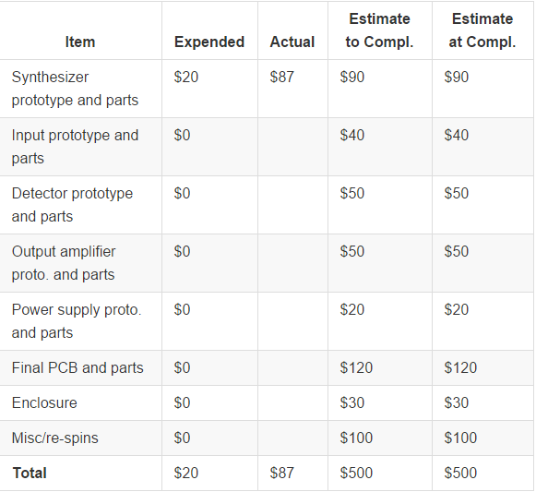
WCP52 USB Gain/Phase Analyzer
Project Finances: 500$

Slide 12
WCP52 USB Gain/Phase Analyzer
Major Issues
Schedule. Project is complicated, relies on many external services (PCB fabrication, parts, sampled parts)

